Slide 1

ARCHITECTURE REVIEW & STRATEGY
Kong Gateway LTS Upgrade
Migration Execution Blueprint: Transitioning seamlessly from 3.4 LTS → 3.10 LTS → 3.14 LTS

Slide 2
Upgrade Strategy at a Glance
Business Continuity & Reliability
0%
By leveraging a dual-cluster Blue/Green Control Plane and Data Plane isolation deployment, API proxy traffic experiences zero disruption during schema and runtime transformations.
Automated decK CLI file conversions enable 100% entity schema validation across versions 3.4, 3.10, and 3.14 LTS releases prior to production cutover.
Downtime Target

Slide 3
Architectural Phase Overview
Evaluating version milestones, security baseline changes, and operational prerequisites across the 3.x release series.

Slide 4
Major Technical & Breaking Changes
3.4 → 3.10 Migration Shift
3.10 → 3.14 Migration Shift
OpenSSL 3.2 Upgrade: Enforces Security Level 2. RSA/DSA keys under 2048 bits and ECC keys under 224 bits are prohibited.
Default Protocols: Route default protocol is strictly HTTPS-only to safeguard endpoints by default.
OIDC & Auth Plugin Schemas: consumer_claim field formatted to array of arrays; headers claims unified.
Deprecations: Cassandra DB support removed; Alpine and Ubuntu 18.04 builds discontinued.
Lua Security & Cryptography: Untrusted Lua sandbox defaults to strict; SHA1 deprecated in favor of SHA256.
Config Validation: Strict integer type checks applied to batch sizes and retry parameters.

Slide 5
Feature & Breaking Changes Matrix
Architectural Vector | Kong 3.4 LTS | Kong 3.10 LTS | Kong 3.14 LTS (Target)
TLS / SSL Security Level | OpenSSL 1.1 / Level 1 | OpenSSL 3.2 / Level 2 | OpenSSL 3.2 / Level 2 + Strict TLS verify
Default Route Protocol | http, https | http, https | https (Secure by default)
OIDC Schema Format | Legacy Array of Strings | Legacy Array of Strings | Array of Arrays (consumer_claims)
Lua Execution Engine | Lax Sandbox | Lax Sandbox | Strict Sandbox (Network calls isolated)
Database Support | PostgreSQL / Cassandra | PostgreSQL only | PostgreSQL / DB-less / Konnect Hybrid

Slide 6
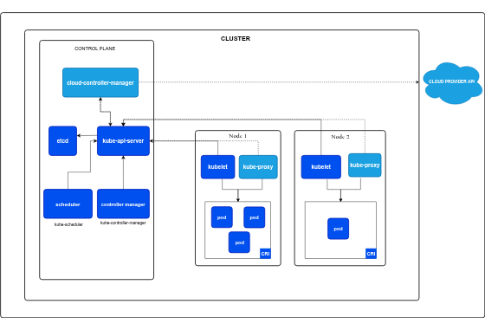
Dual-Cluster Architecture Blueprint
To mitigate runtime risk, we employ a Dual-Cluster Blue/Green strategy during Control Plane (CP) and Data Plane (DP) migration:
•
Control Plane Isolation: Stand up a parallel 3.14 CP cluster backed by converted PostgreSQL schema.
•
Decoupled DP Migration: Roll Data Plane worker nodes progressively without touching active 3.4 DP nodes.
•
DNS Traffic Shift: Switch ingress load balancer traffic seamlessly once canary health checks pass.
•
Instant Fallback: Revert DNS endpoints immediately back to Blue cluster in case of unforeseen edge anomalies.

Slide 7
Four-Phase Migration Timeline
Phase 2: decK Convert
Phase 4: Prod Shift
Run decK 1.57+ convert (3.4 → 3.10 → 3.14). Validate YAML on staging environment.
Provision Prod Green cluster, execute canary traffic shifting, & decommission Blue nodes.
Phase 1: Audit
Phase 3: Staging E2E
Audit 3.4 plugin configs, custom Lua code, weak TLS certs, and decK schema rules.
Deploy 3.14 Green CP & DP in Staging. Perform synthetic load & auth regression testing.

Slide 8



Infrastructure Prerequisites
Database & Storage
Compute Capacity Burst
decK CLI Tooling
PostgreSQL 13+ required. Complete full database snapshots and verify keyring encryption keys prior to running decK migrations.
Provision +100% temporary DP compute capacity to support dual-cluster coexistence during canary rollout window.
Upgrade decK CLI to v1.57.3 or higher across CI/CD runners to enable automated schema conversion flags (--from 3.10 --to 3.14).

Slide 9
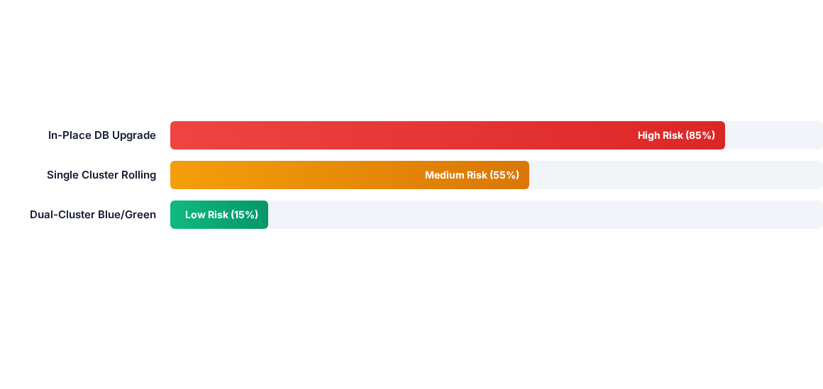
Upgrade Strategy Risk Comparison
Dual-Cluster Blue/Green deployment minimizes operational downtime and risk by isolating state changes and providing instant rollback capabilities.

Slide 10
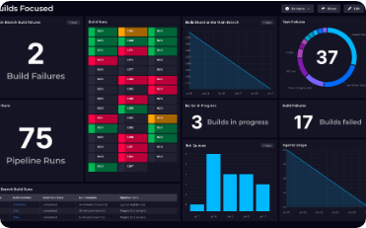
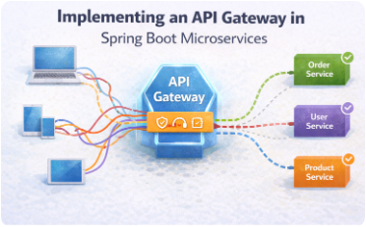
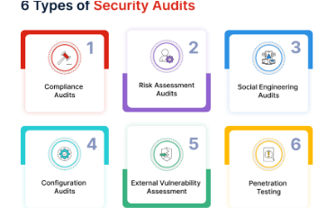
Core Team Responsibilities
DevOps & Infra Team
API Engineering
Security & Compliance
Infrastructure provisioning, Helm/Kubernetes manifests update, and Blue/Green ingress traffic routing control.
Custom Lua plugin refactoring, decK file conversion audits, and downstream API consumer testing.
Certificates audit for RSA 2048+ compliance, OIDC header claim validation, and keyring recovery testing.

Slide 11

Governance & Cutover Protocol
Strict Sign-off Gates
Every phase transition requires explicit engineering and business verification. Automated decK dry-runs must report zero schema warnings prior to cutover.
In the event of anomalous latency or error rate spikes exceeding 0.01%, traffic automatically reverts to the 3.4 Blue cluster within 30 seconds.

Slide 12
Executive Q&A & Next Steps
Thank you. We welcome questions and discussion regarding the architectural roadmap.
Infrastructure Architecture Team | Enterprise Gateway Taskforce

Slide 13





Image Sources
https://kubernetes.io/images/docs/kubernetes-cluster-architecture.svg
Source: kubernetes.io
https://squaredup.com/_next/image/?url=https%3A%2F%2Fcdn.sanity.io%2Fimages%2Fz7wg6mcy%2Fproduction-2025%2Fc55d5bc1a28449412300df2c17a2f7e4218623d2-1920x1080.png%3Fq%3D100%26fit%3Dmax%26auto%3Dformat&w=3840&q=75
Source: squaredup.com
https://miro.medium.com/1*zvHcA-fU5ORrZ7nrXEow6Q.png
Source: medium.com
https://marvel-b1-cdn.bc0a.com/f00000000310757/www.fortinet.com/content/dam/fortinet/images/cyberglossary/6-types-of-security-audits1.png
Source: www.fortinet.com
https://phoenixictsolutions.com/assets/img/hero-zara.png
Source: phoenixictsolutions.com

